Slide 1
Feature Selection

Slide 2
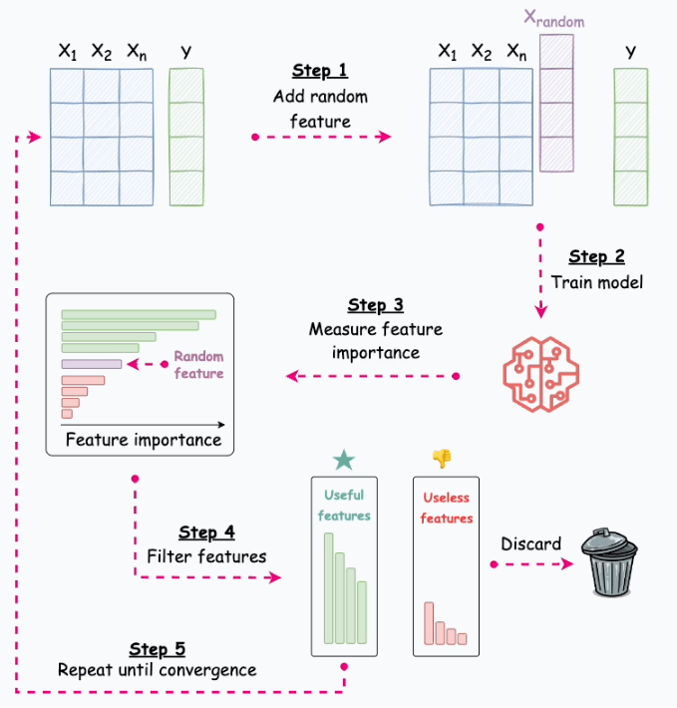
Probe method: A reliable feature selection technique in ML.

Slide 3
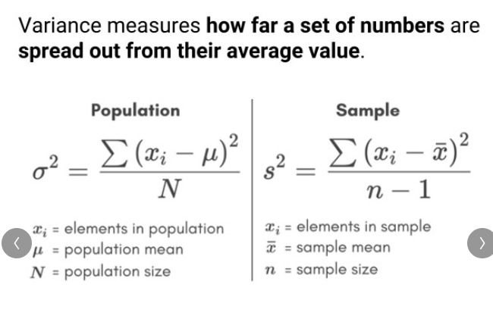

Slide 4
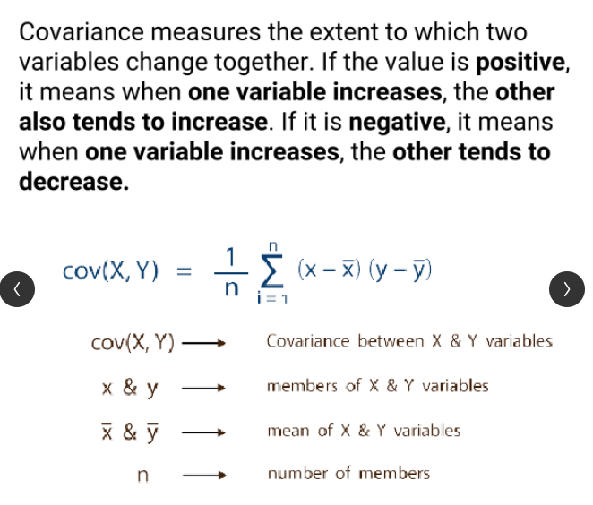

Slide 5
